Slide 1
Wimborne Model Town (WMT)
River System Water Sustainability Project
Canford School
Projects Inaugural Meeting
22nd January 2018

Slide 2
Points for Discussion
Introductions / meet the team
Health and Safety
Familiarisation with site and facilities
Introduction to on-line Forum – Working on engineering projects as part of a team.
The development process and expected deliverables.
General Q&A
Detailed Q&A on projects with individuals

Slide 3
INTRODUCTIONS
Wimborne Model Town:
  Greg Hoar – WMT Manager
  Stuart Laybourne – WMT Deputy Manager?
WMT River System Team:
  Penri Jones – Team Leader, Hardware, Planning, Groundwork.
  Terry Coles – Systems, Hardware, Software.
  Hamish McIntyre-Bhatty – Software, Groundwork.
  Clive Wills – Mechanical / Craftwork.

Slide 4
Health and Safety
Does the WMT have a H&S Policy (I presume it does).

Slide 5
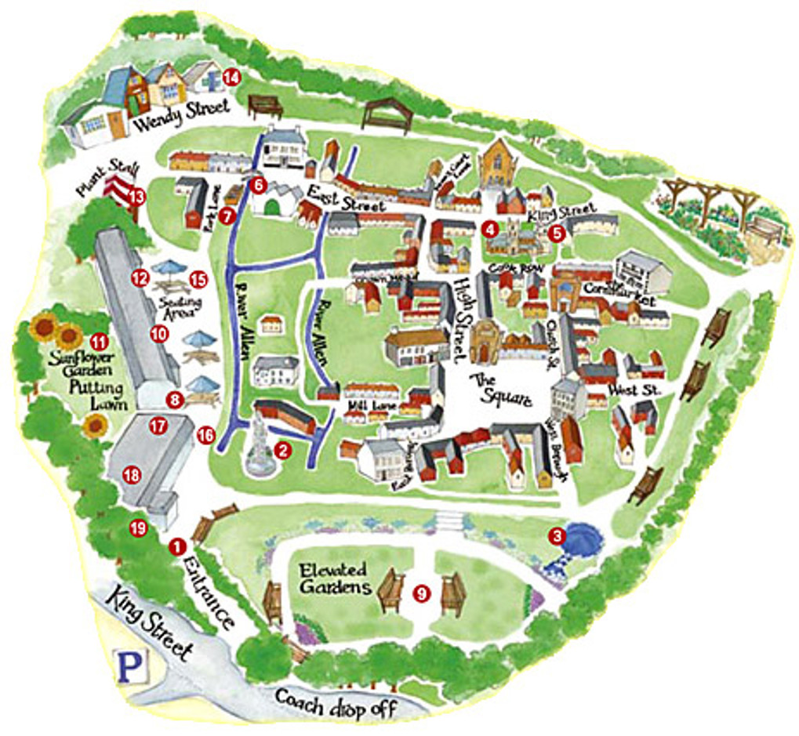
FAMILIARISATION WITH SITE AND FACILITIES

Slide 6
Water Sustainability Project Goals
Save water (money):
  Stop leaks.
  Better rainwater storage.
  Active water management.
Save the environment:
  Use less water.
  Cleaner water (less algae, etc).
  No pollution (no chemicals, metals, hydrocarbons, etc).
Education:
  For Visitors (the people who pay to get in).
  For Students (the people from local schools).

Slide 7
INTRODUCTION TO ON-LINE FORUM
Access
The Project Teams at WMT maintain an online Forum at http://wmtprojectsforum.altervista.org/forum/index.php.
This Forum is not just for the River System Project, but has been used extensively for discussion about the work to date.
The Forum may be viewed by anyone, but to post, a login is required. This can be created from the Home Paage by clicking on the 'Register' link at the top right of the page.

Slide 8
INTRODUCTION TO ON-LINE FORUM
WORKING ON ENGINEERING PROJECTS AS PART OF A TEAM
The Forum is a very useful tool which aids the development of the work in many ways:
  Primarily, it is a very efficient means of communication. Earlier projects relied heavily on email and face to face discussions, but this has a number of disadvantages.
  The use of a forum helps with teamwork because:
    Team members who become involved later can review the earlier work.
    Topics can be discussed and agreed in some detail before work begins.
    Face to face meetings are much more efficient, because much of the discussion has already happened.
    A written record exists of all points of view and decisions taken.

Slide 9
THE DEVELOPMENT PROCESS
WMT projects use a development process which has been proven in Industry over many years:
  Requirements are written and agreed by the 'Stakeholders'.
  A Design is proposed and accepted.
  The system is implemented and tested; a process known as Integration.
  The completed system is presented to the WMT management (who have been pretty involved from the start so problems at this stage are rare).

Slide 10
EXPECTED DELIVERABLES
Deliverables might include:
  A Design document, that details the solution to the specific Requirements.
  A working version of the solution which might be:
    A software program.
    A piece of hardware.
    A change to the river environment.
  Where applicable, detailed maintenance and repair information.
  A demonstration of the solution in situ.

Slide 11
Questions and Answers
General:
  On any topic relating to the work process or deliverables.
Projects with individuals:
  Split into the various teams.

